Slide 1

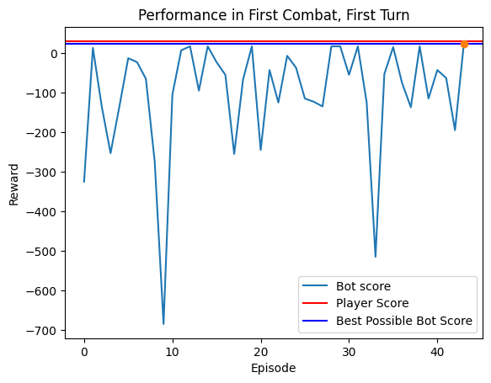
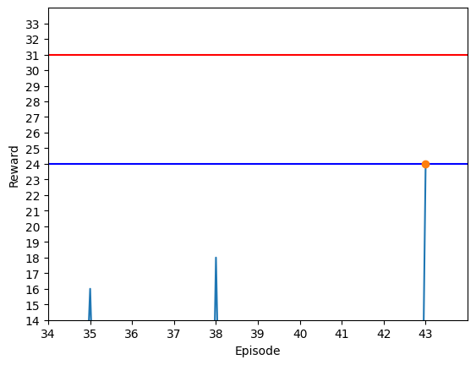
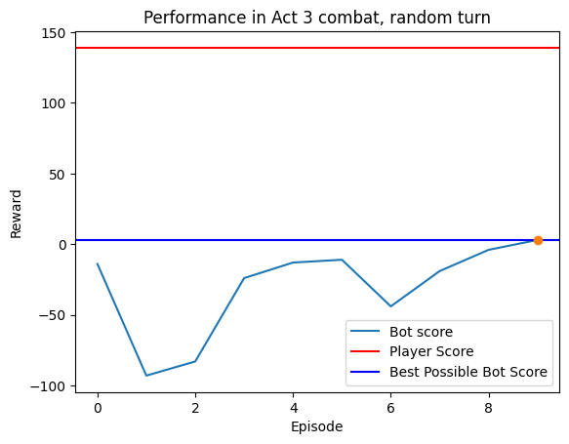
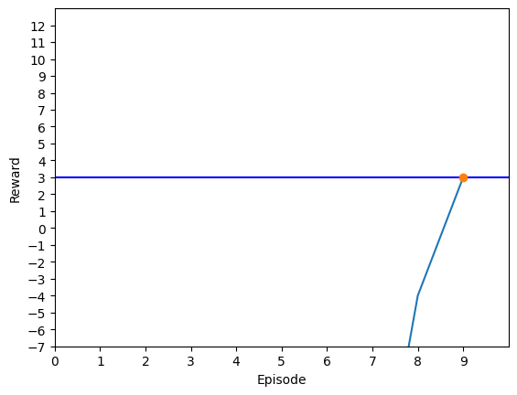
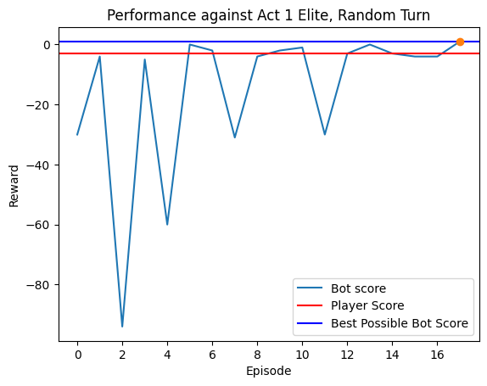
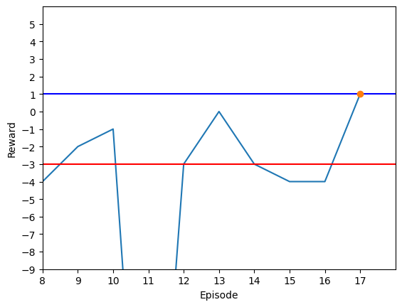
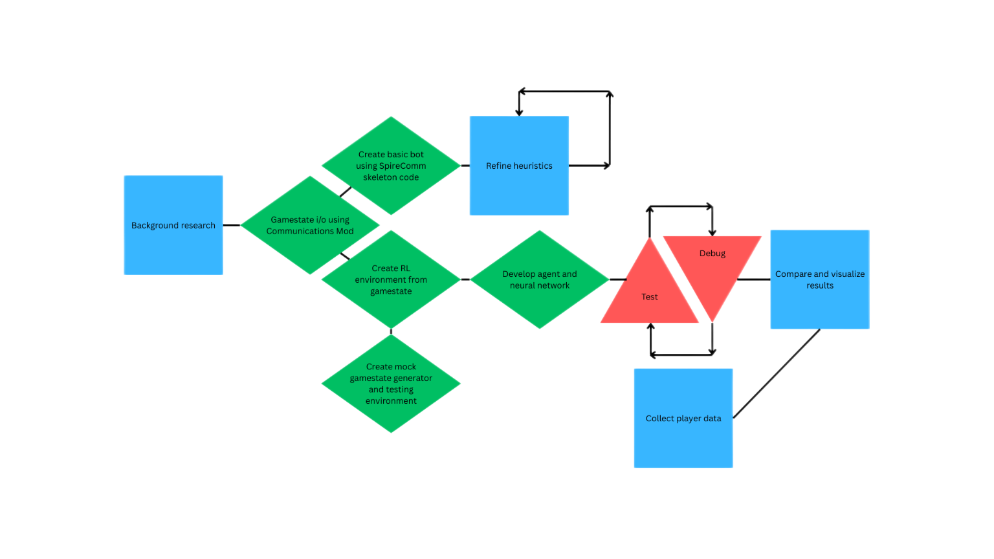
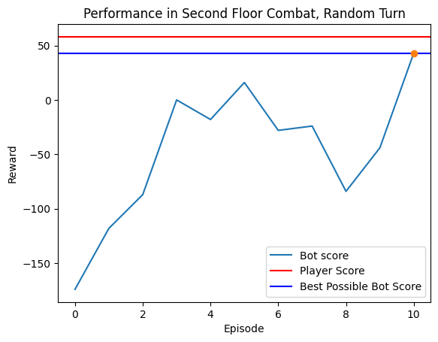
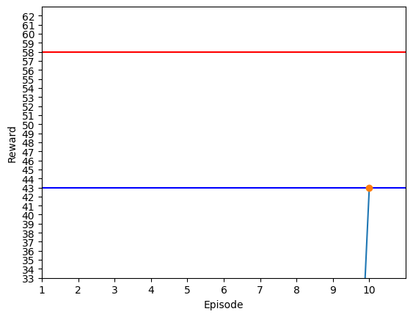
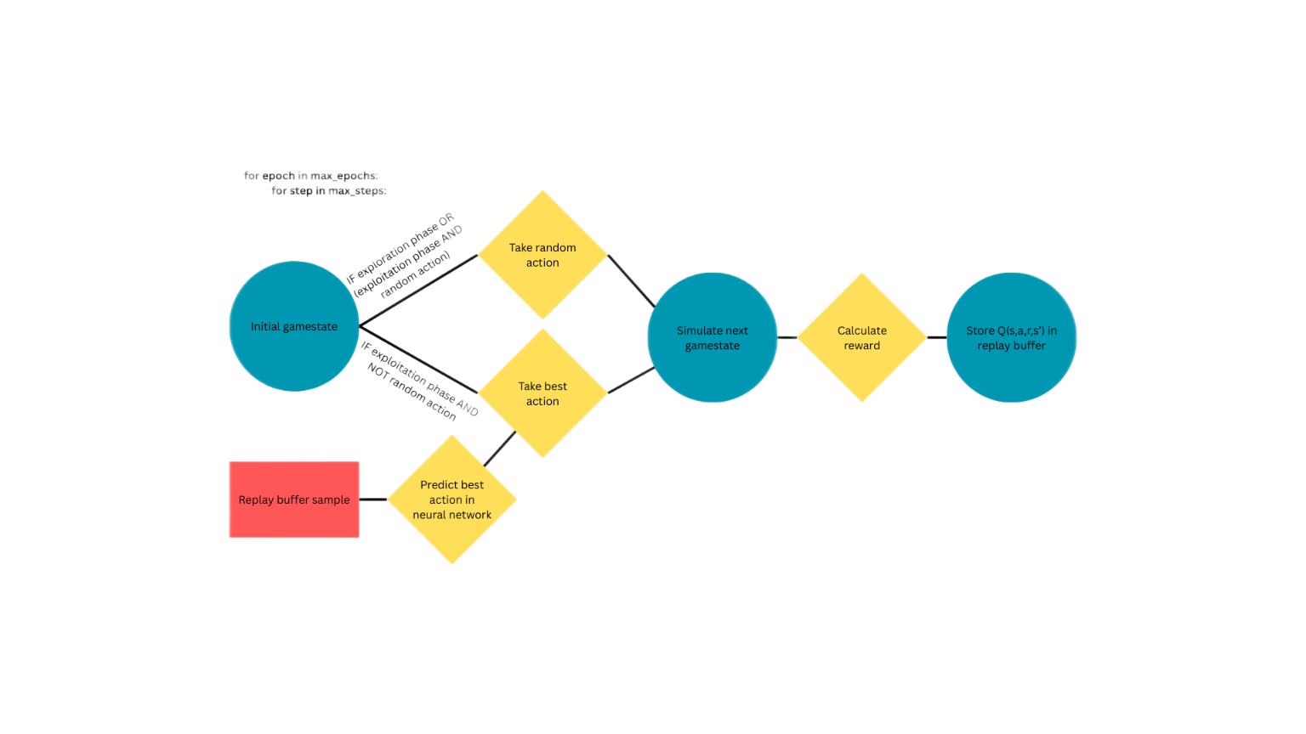
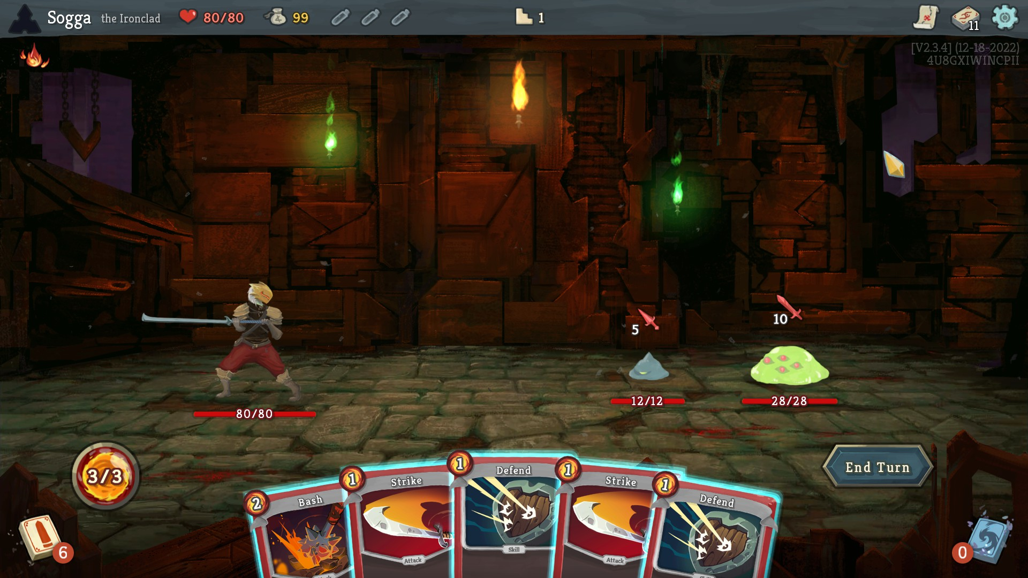
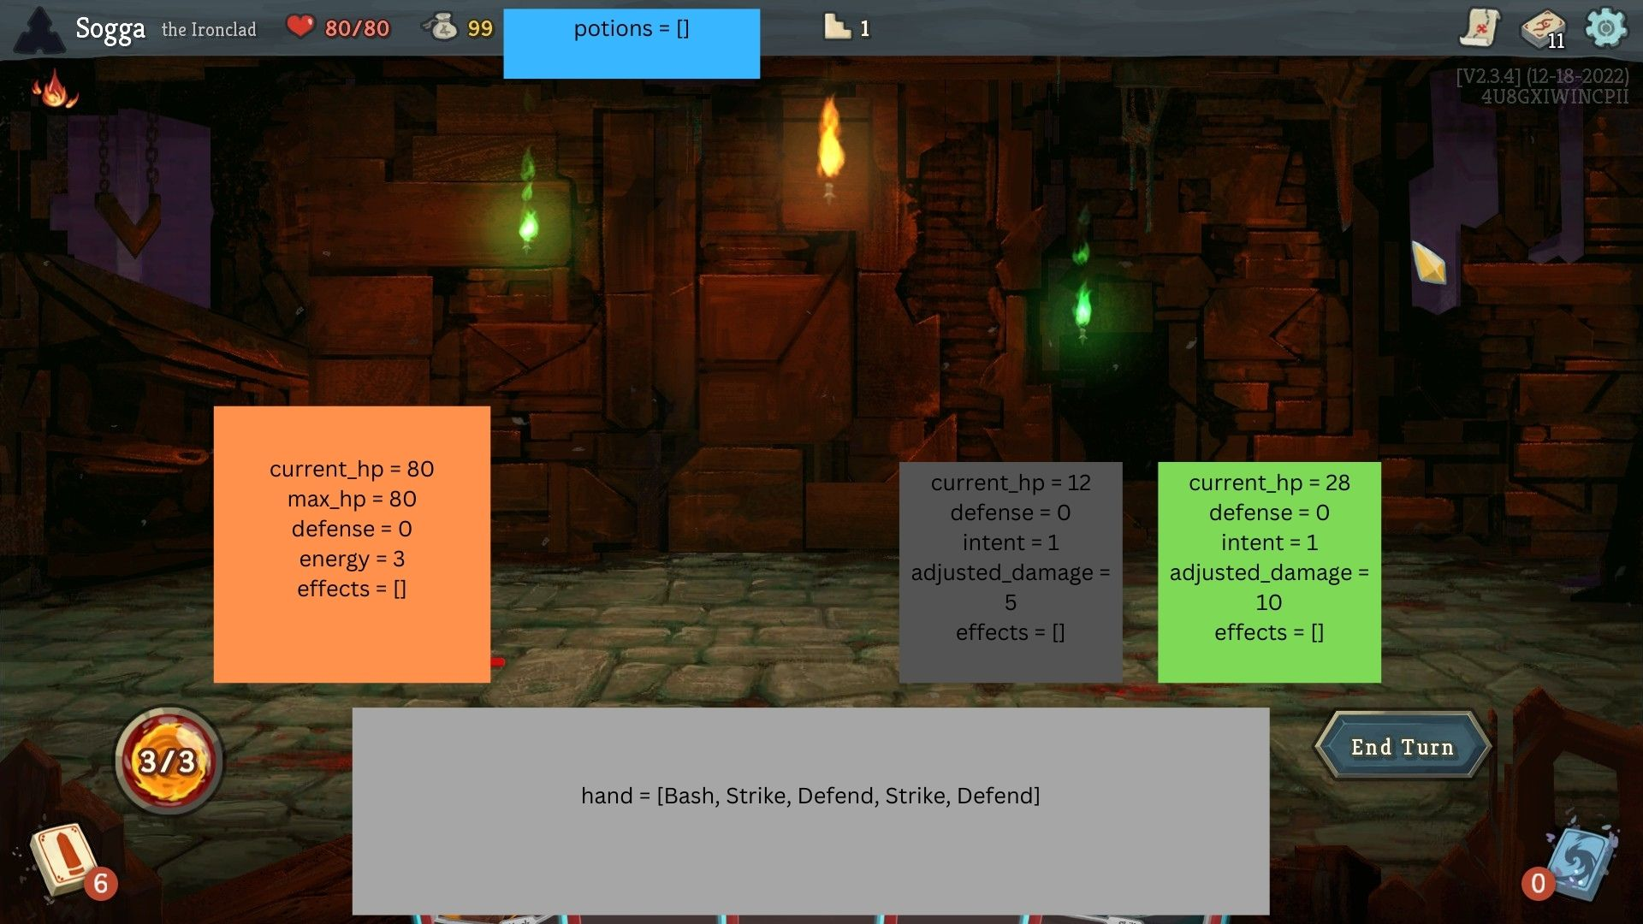

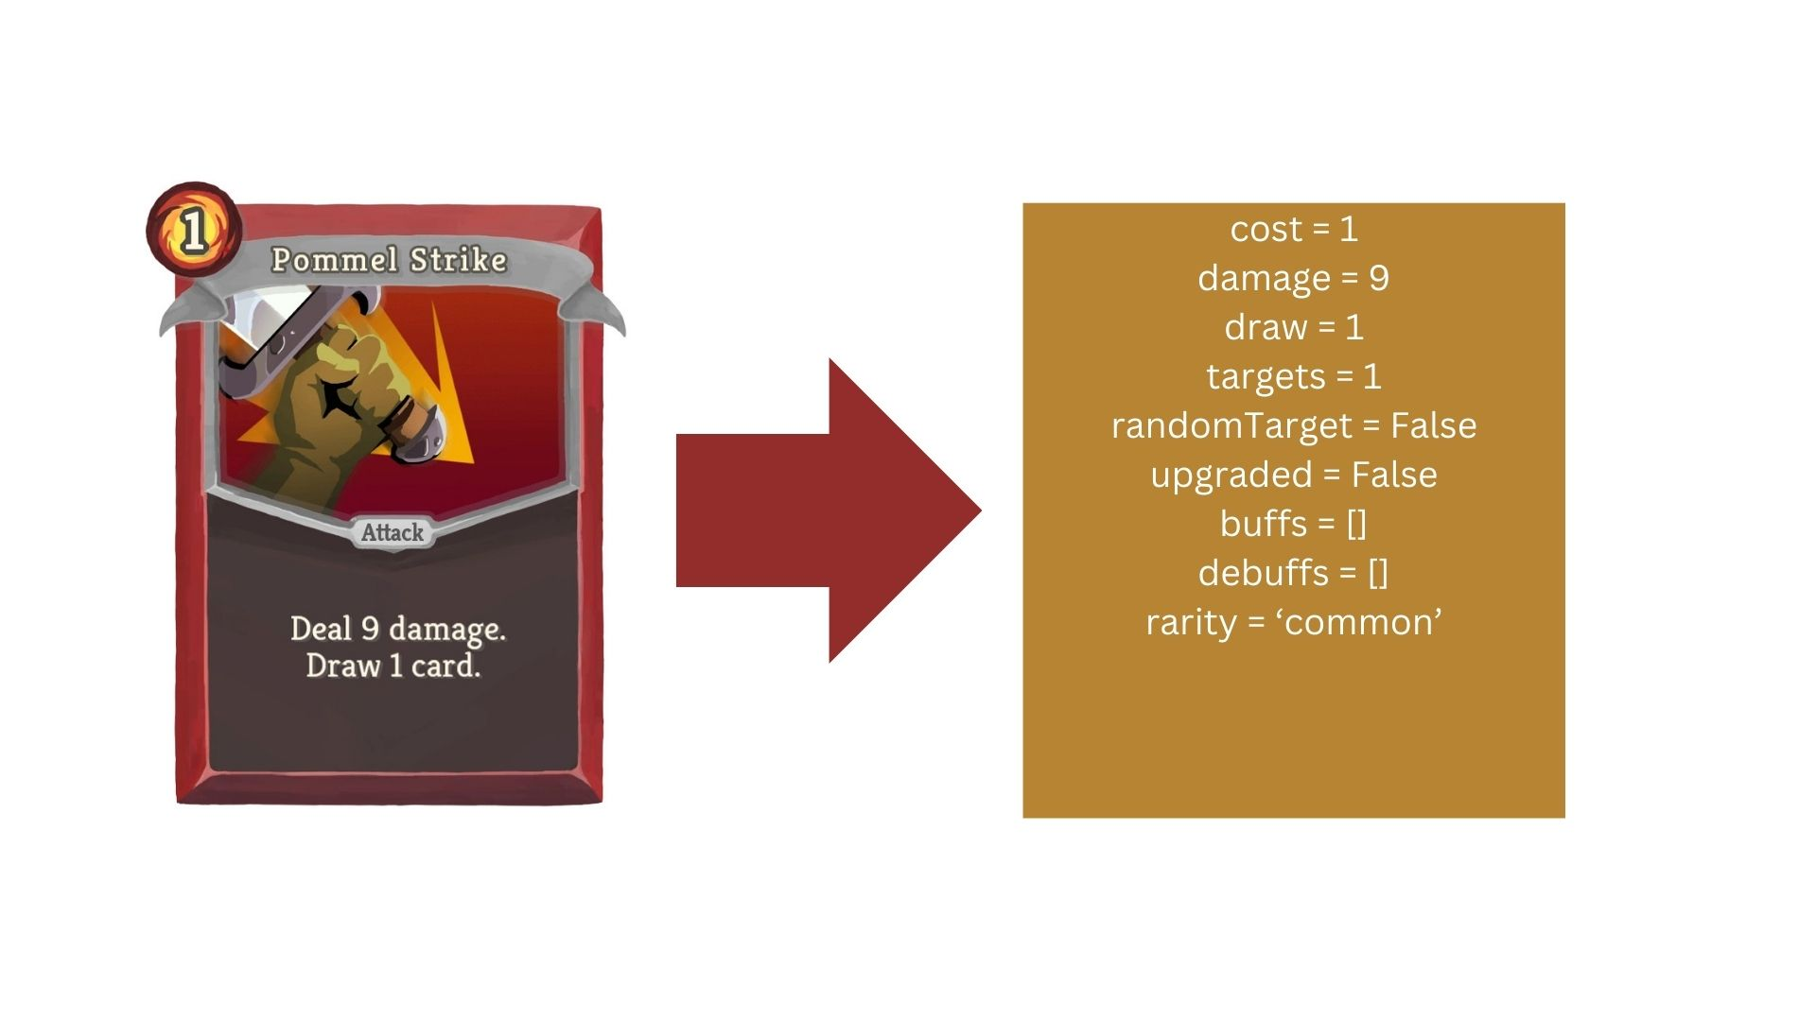
Deep Reinforcement Learning in Slay the Spire Card Play
Greyson Henry
Background
Results
This project focuses on autonomous play in complex, high state-space video games. For example, in Slay the Spire (StS), released by Mega Crit Games in 2017, players are tasked with climbing the titular Spire one floor at a time, responding to enemies and events they encounter along the way. Many aspects of StS are randomized per run; card rewards, available paths, encounter order, shop contents, and many other elements are never the same between two games. Thus, StS boasts a tremendously high number of gamestates (combinations of in-game elements), rendering traditional supervised and unsupervised optimization techniques too slow to use for autonomous play. Instead, I implement deep reinforcement learning (RL)—an algorithmic “agent” that learns based on reward and punishment—to find the best card play order strategy on the fly. This research contributes to our understanding of RL implementations in high state-space games.
Fig. 1: 43 tries to find best hand (Act 1, Combat 1, Hand 1)
Fig. 4: 9 tries to find best hand (Act 3, Combat 1, Hand 1)
Analysis
These charts display the agent’s performance across four hands picked from across the game: one from the very first hand of the game, plus three from random hands at random points in each of Spire’s 3 Acts. In each hand, the agent was able to find the global reward maximum for the hand—the best possible outcome using the agent’s logic.
Why so much fluctuation in reward across episodes?
The agent has a “toolbox” of actions equal to the length of the hand, with 1 action for each card. If the size of the hand decreases, however, the agent doesn’t lose the action associated with the lost card. If the agent tries to use an action tied to a card no longer in hand, it’s hit with a hefty penalty, causing the fluctuations in reward. The fix for this is called “action masking”, which I haven’t implemented yet.
Why does the agent sometimes fall short of the player score?
This is because the agent’s gameplay logic isn’t 1:1 with the actual game logic. In particular, the agent’s gamestate simulation struggles with drawing cards, a crucial mechanic in StS. Better logic can be hard-coded in.
Methodology
Fig. 2: 17 tries to find best hand (Act 1, Combat 4, Hand 3)
Workflow for the creation of the agent and bot
Fig. 3: 10 tries to find best hand (Act 2, Combat 7, Hand 2)
Gamestate Representation
Reinforcement Learning Cycle
Next Steps
References
Improve card and enemy logic in simulated play
Implement action masking to avoid impossible/“missed” actions
Dynamically receive game state via Communication Mod
Apply RL play order in-game via Communication Mod
Improve heuristics for pathing, drafting, menu navigation
Continue research into RL techniques
Consider using RL in pathing, drafting, and menu navigation parts of StS
Optimize max_steps, max_epochs hyperparameters for better learning
Mega Crit Games. Slay the Spire. Mega Crit Games. PC/Mac/PlayStation 4/iOS/Android.
u:ForgottenArbiter. CommunicationMod. https://github.com/ForgottenArbiter/CommunicationMod
u:xaved88. BottledAI. https://github.com/xaved88/bottled_ai
Literature matrix:
What players see
The agent makes its decisions using a type of reinforcement learning called deep Q-learning, supported by a reward policy called epsilon greedy. Given a certain gamestate, the agent uses a neural network to estimate the reward for each of its available actions—in this case, a set of possible card plays. From there, the agent simulates the next game state and calculates an actual reward value associated with the action. Finally, the information about the current gamestate, action, reward, and simulated gamestate are bundled together and stored in memory to help the neural network make better decisions in future turns. This repeats for every card play permutation possible before ending the turn. At first, the agent starts out in “exploration mode”, selecting actions randomly and seeing what happens. Once it has a maximally-profitable action sequence, it goes into “exploitation mode” and taps that sequence over and over, occasionally trying new things.
What the agent
sees
Acknowledgements
Thanks to Dr. Tartaro, Genevieve Ovsak, Brady Fleuette, Brycen Addison, Hanna King, Charlie Fink, Deen Deovic, and Matthew Keller for their feedback. Thanks to Dr. Sultan for helping me get this project off its feet.
Player vs agent view
(cards)
Player view
Agent view

